Slide 1

Heart Disease Prediction Using Logistic Regression
PROJECT BY: ATRAYEE NAG
GUIDED BY: MISS NAINA DEVI
Notes:
1

Slide 2
Agenda
1.Project Introduction
2.Tools & Technologies
Understanding the problem and approach
Technical stack and frameworks
3.Project Working
4.Applications & Impact
Implementation and results
Real-world use cases
5.Challenges & Solutions
6.Future Enhancements
Lessons learned
Next steps and scalability
Notes:
2

Slide 3

Introduction to the Project
The Challenge
Heart disease remains the leading cause of death globally, accounting for approximately 17.9 million lives annually. Early detection is critical for prevention and effective treatment.
Our Solution
This project develops a machine learning model using logistic regression to predict the likelihood of heart disease based on patient health metrics, enabling early intervention and better patient outcomes.
Notes:
3

Slide 4
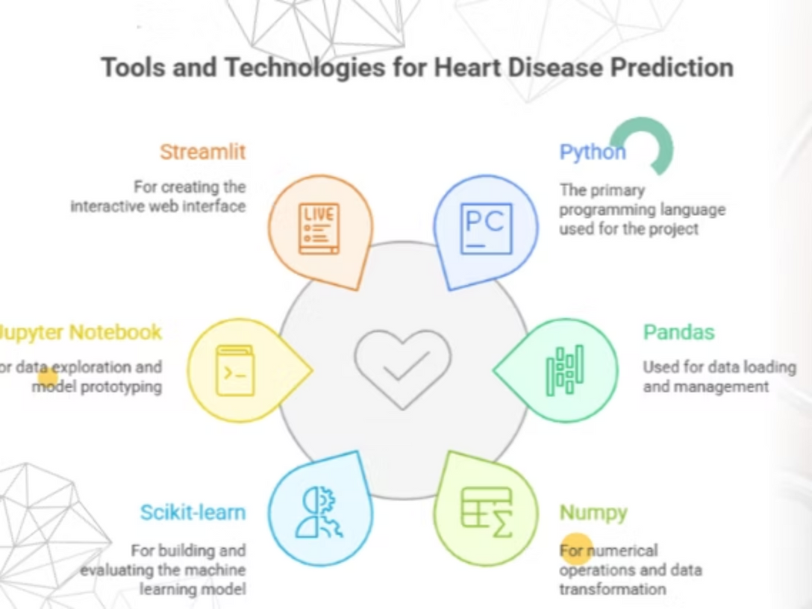
Tools and Technologies
Programming Language:
Python
Data Analysis & Machine Learning:
Pandas: For loading and managing the heart.csv data.
Numpy: For numerical operations and data transformation.
Scikit-learn (sklearn): For building the LogisticRegression model and checking its accuracy_score.
Jupyter Notebook: For initial data exploration, visualization (heatmap), and model prototyping.
Web Application (Front-end):
Streamlit: To create the interactive web interface (app.py) with sliders, buttons, and real-time output.
Notes:
4

Slide 5

Project Working: Data Overview
Dataset Features
The model analyzes 13 key health parameters including age, sex, chest pain type, resting blood pressure, cholesterol levels, fasting blood sugar, ECG results, maximum heart rate, exercise-induced angina, and ST depression values.
303
13
Patient Records
Features
Comprehensive dataset for training
Clinical parameters analyzed
Notes:
5

Slide 6
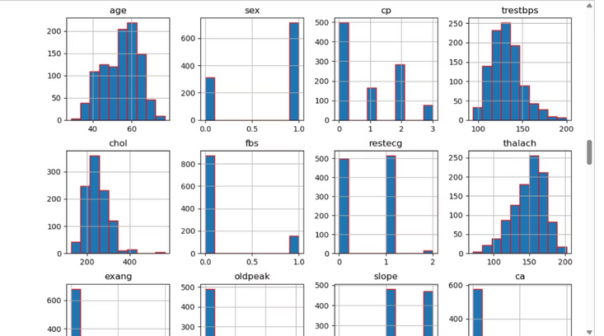
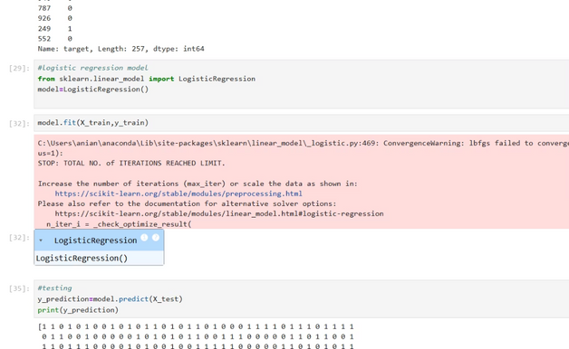
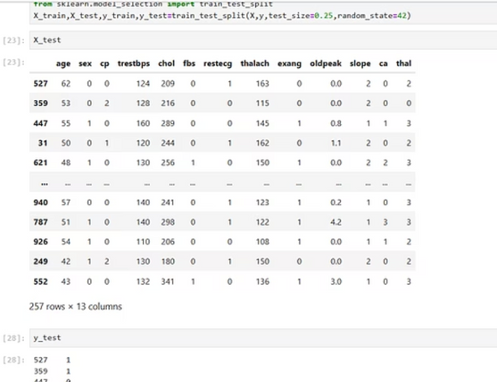
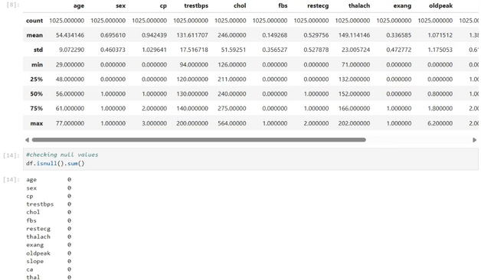
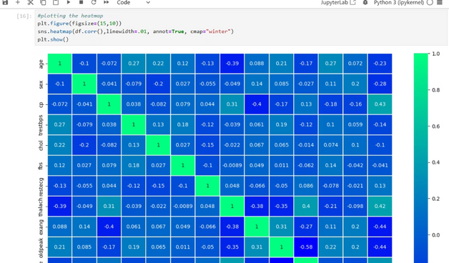
Model Performance Results
Key Performance Metrics
Our logistic regression model demonstrates strong predictive capabilities with balanced precision and recall, making it reliable for clinical decision support.
Notes:
6

Slide 7
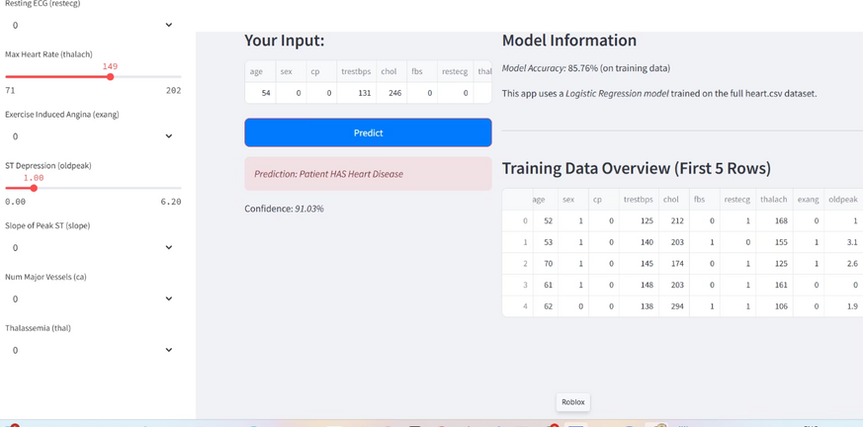
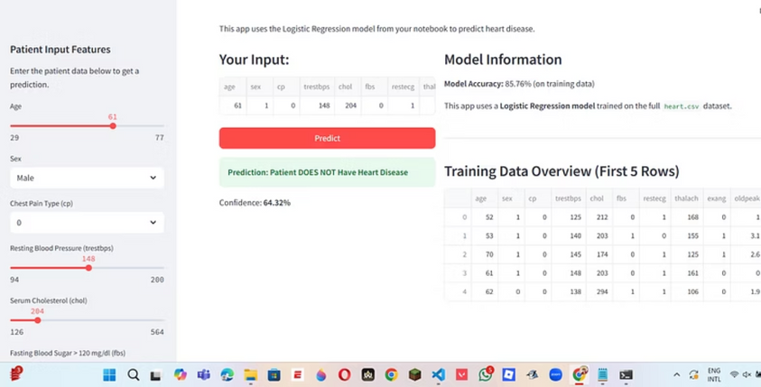
Output Screenshots
The Model analysis reveals that chest pain type, maximum heart rate achieved, and ST depression are the strongest predictors of heart disease in our model.
Notes:
7

Slide 8
Real-World Applications
Clinical Decision Support
Preventive Healthcare Programs
Assists healthcare professionals in identifying high-risk patients during routine checkups, enabling timely referrals to cardiologists for comprehensive evaluation.
Enables hospitals and clinics to implement targeted screening programs, focusing resources on patients with elevated risk factors for cost-effective prevention.
Telemedicine Integration
Health Insurance Risk Assessment
Provides remote patient monitoring capabilities, allowing healthcare providers to assess heart disease risk from patient-submitted health data in underserved areas.
Supports insurance providers in accurate risk profiling and personalized premium calculation based on scientifically validated health metrics.
Notes:
8

Slide 9



Challenges & Solutions
Imbalanced Dataset
Challenge: Unequal distribution of positive and negative cases affected model training.
Solution: Properly splitted the training and testing data and operated on it.
Locating Path
Challenge: Unable to locate my folder of project
Solution: Saved all the files in a single folder where the jupyter extensions are.
Model Interpretability
Challenge: Medical professionals required clear explanations for predictions to trust the system.
Solution: Generated visualizations and coefficient analysis to provide transparent, interpretable results.
Notes:
9

Slide 10

Future Scope
Enhancement opportunities
Multi-Disease Prediction: Expand model to predict related cardiovascular conditions.
Improving the interface: Working more on the frontend part.
Real-Time Monitoring: Integrate with wearable devices for continuous risk assessment.
Mobile Application: Develop user-friendly app for patient self-screening.
External Validation: Test model on diverse populations for generalization.
Notes:
10

Slide 11
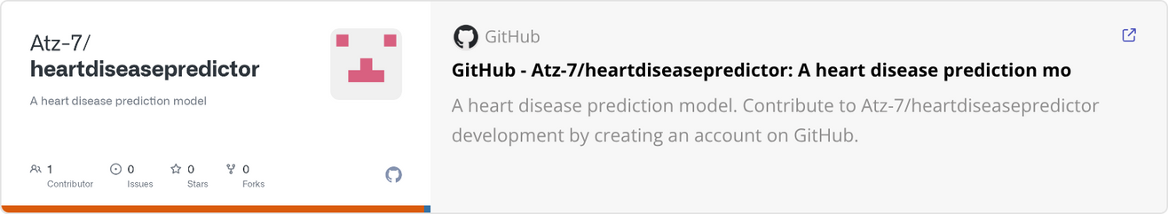
Access the Project
THANK YOU!

